Slide 1
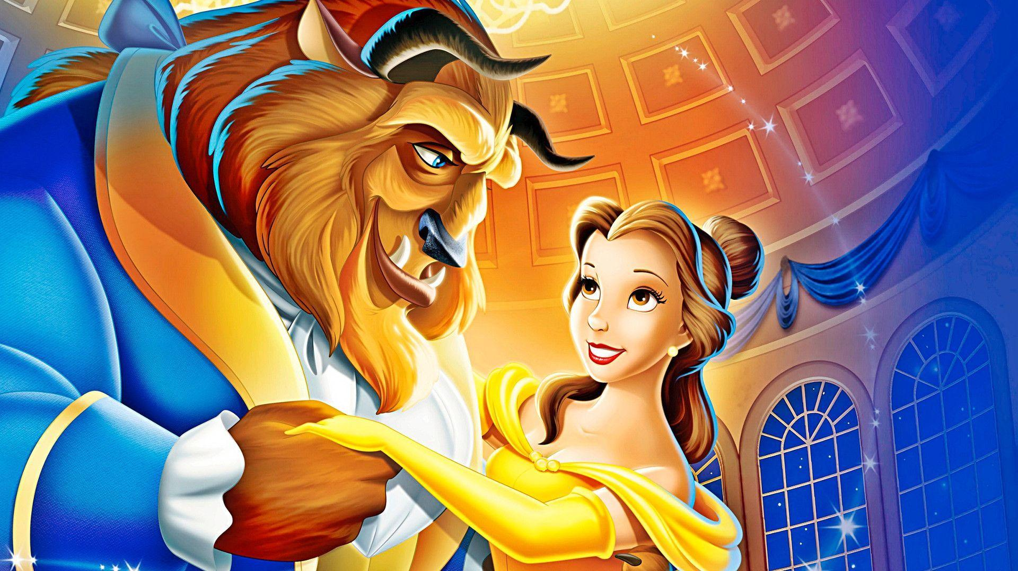
Gender Bias in Fairy Tales
By: Lisa van Gelderen, Alexia Muresan, Zoë Prins & Victor van der Sman

Slide 2
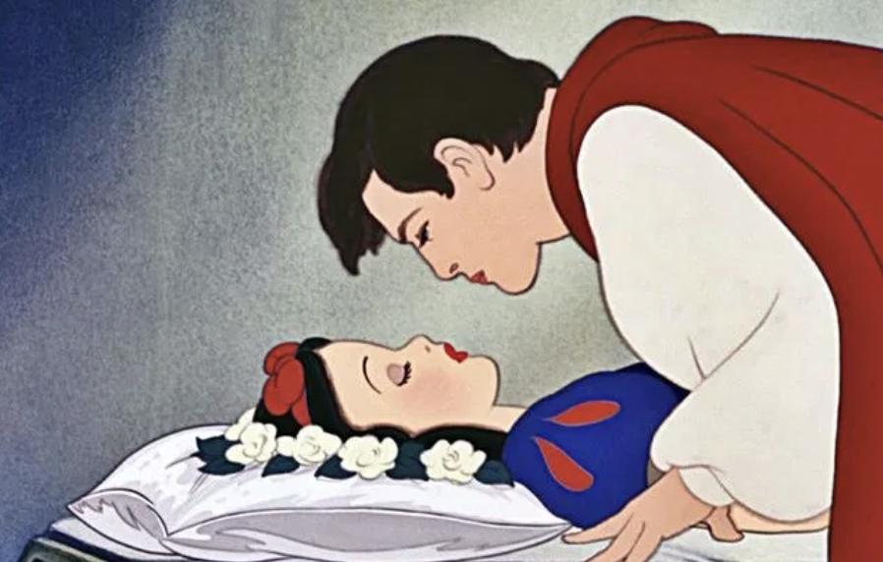
Introduction
Grimm and Anderson fairy tales
Gender bias
Contemporary research about gender bias in fairy tales:
Importance of appearance
Traditional gender roles
Gender hierarchy
-> Expose new generations to stereotypical representations of gender
Brave saviour
Pretty and helpless
Picture source:
ourcehttps://wgntv.com/news/trending/disneylands-snow-white-ride-criticized-for-kiss-without-consent/

Slide 3
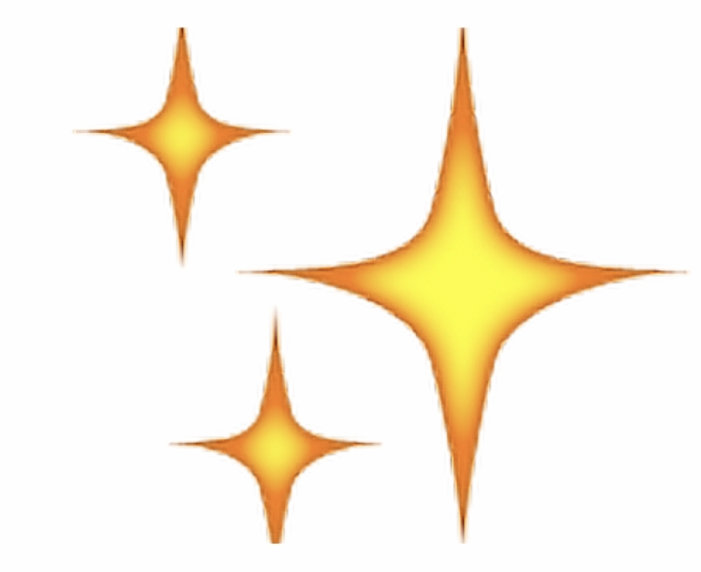
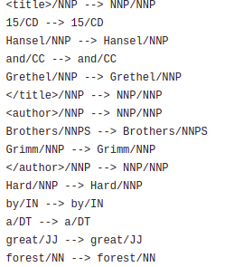
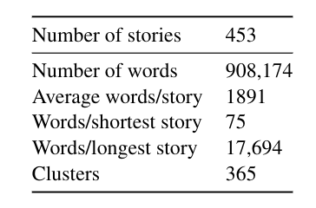
The dataset
Where did we find the dataset?
What can we tell you about the dataset?
What have we done with the data to process it?
['hansel', 'grethel', 'brothers', 'grimm', 'hard', 'great', 'forest', 'dwell', 'poor', 'wood-cutter']

Slide 4
Method
Preprocessing the data
N-gram model text generation
Frequent bigram analysis
Word embeddings using surface co-occurence counts
Gensim Word2Vec model, for vector analogies

Slide 5
Results
At home the beautiful wife prayed for her husband and her father. Their clothes were very delicate and fine, for they were made of the leaves of flowers, trimmed with the wings of flies and gnats, which had not a bad effect.
They took each other ' s hand, and at that moment the door of one of the houses opened, and the neighbour appeared. â âPrude ! â exclaimed the collar; and then it was taken out of the washing - tub. There is an old legend about a saint who was allowed to choose one of the seven deadly sins, and who accordingly chose drunkenness, which appeared to him the least, but which led him to commit all the other six." And she gave Vertigo the commission. I am a happy director; for none of my company ever grumble, nor the public either, for I always make them merry. âTo travel ! to travel ! â exclaimed he, overcome by most painful and passionate remembrances. But he did not despair. This was capital.
N-Gram results:
Bigram results:
Woman
Old
Beautiful
Man
Says
Acts

Slide 6
Results
When looking at surface co-occurences we noticed that words describing women were more often near words describing men than the other way around.
When training a gensim word2vec model we saw the vector for princess had high similarity to the one for slave, while this was not the case for prince.
Vector analogies showed us that brave is to father as gracefully is to mother and smart is to boy as moral is to girl.

Slide 7
Conclusion
Answer to the binary reasearch question: "yes."
"Women are more passive than men"
The data showed how women had less active verbs
"Women are more reliant on men"
Female characters have a higher reliance on male characters
"Women are more subject to superficial judgement"
Generally women had a lot more adjectives to describe their appearance than their personality

Slide 8
Discussion & future work
Discussion
Some unused figures and graphs
Bias more abstract than expected
Future work might include
Male bias relating to toxic masculinity in fairy tales
Trying to replicate results from Wardetzky (1990) using NLP

Slide 9
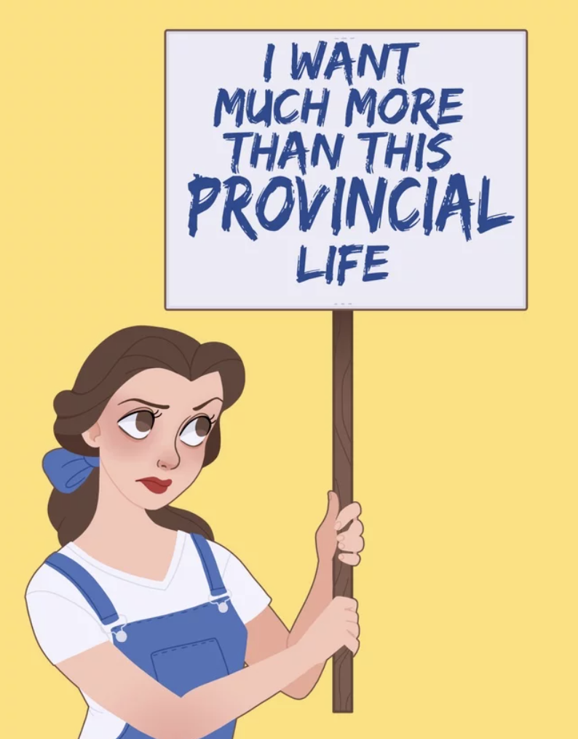
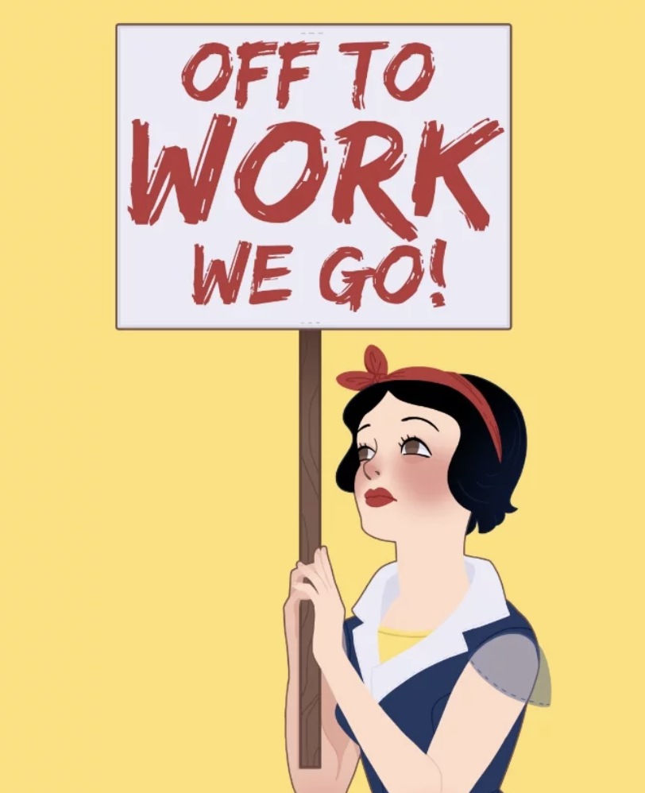
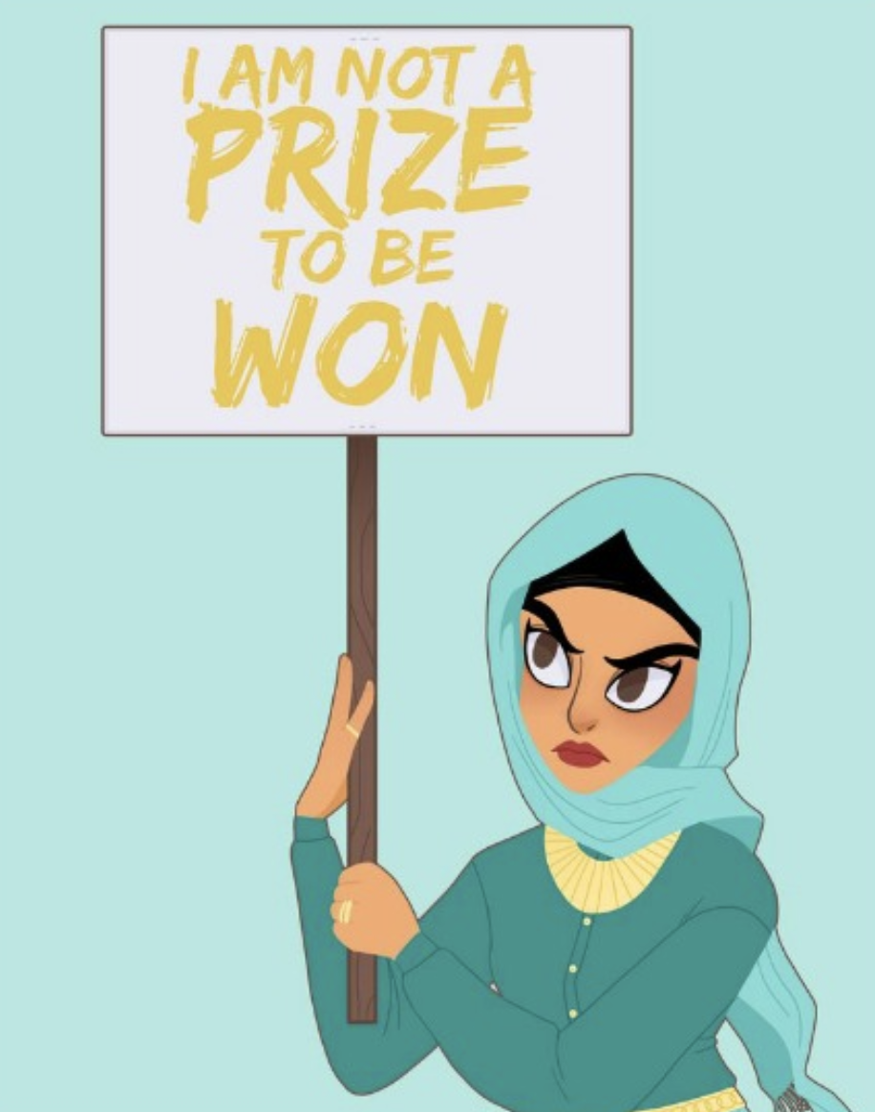
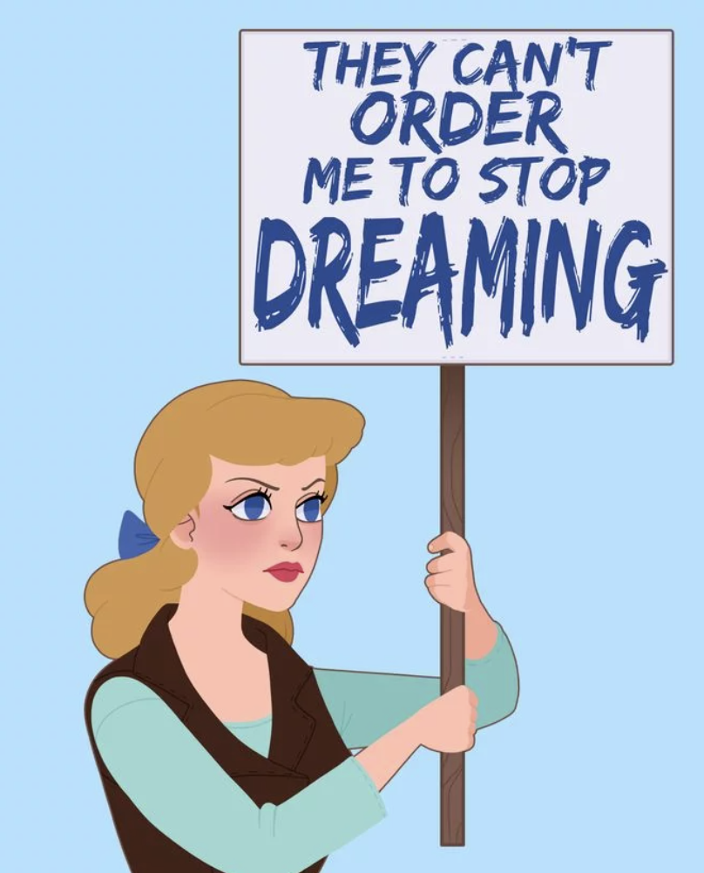
Picture source: https://coolmompicks.com/blog/2017/03/15/protest-disney-princesses-amanda-allen-niday/
Thank you for listening!

Slide 10

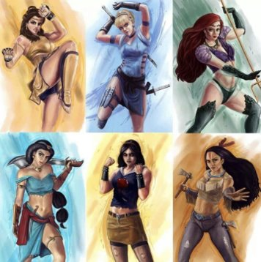
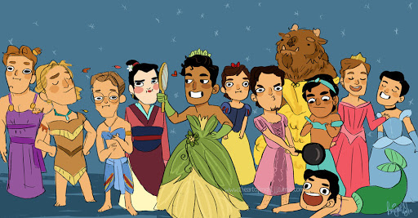
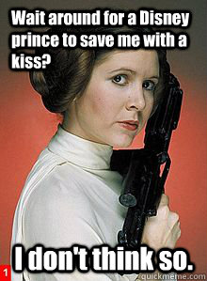
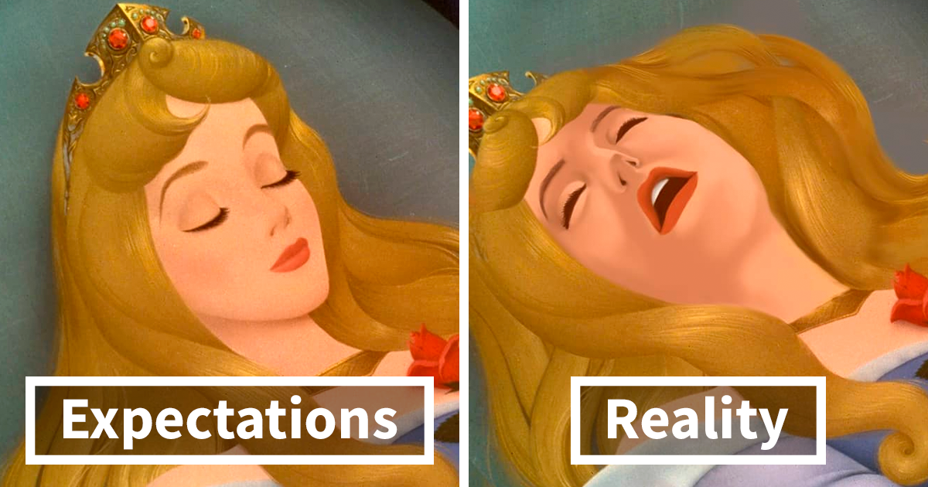
Questions?

